Slide 1
KIP DIXON

Slide 15
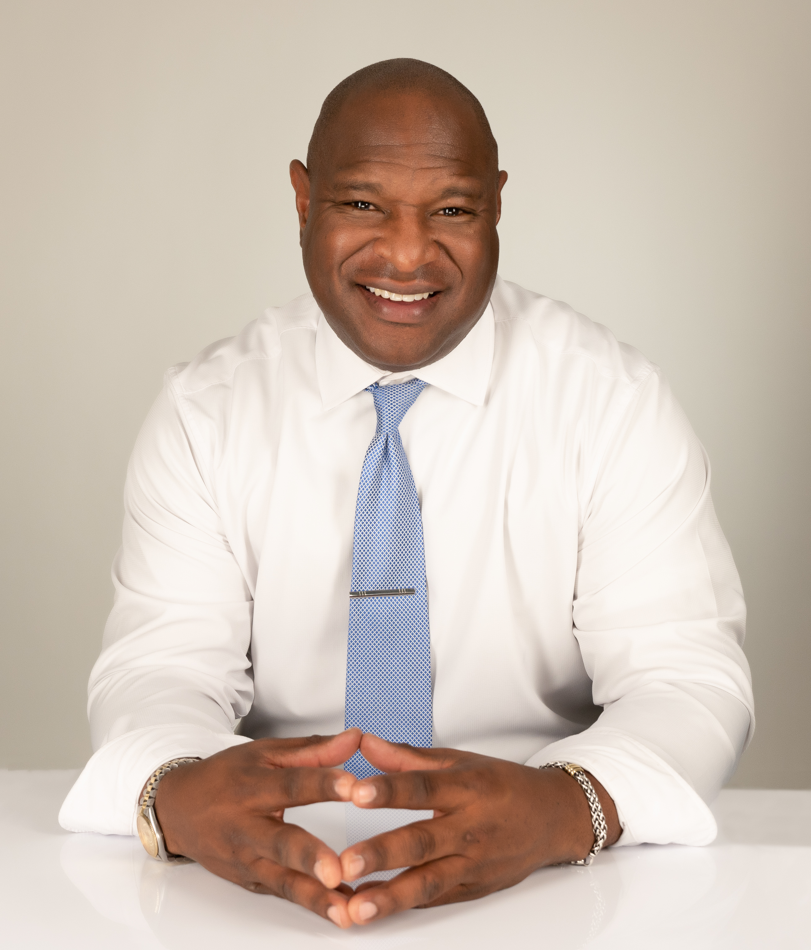
Kip Dixon
Assistant Vice President Community Development
NMLS#1035392
C: (972) 814-3947
D: (214) 491-1403
Kip.Dixon@cadencebank.com
While representing Cadence Bank as a Community Development Mortgage Loan Originator, I have
earned a reputation with customers and real estate professionals alike as a mortgage banker who
consistently offer exceptional customer service as well as helpful advice to individuals in all real estate
transactions. The relationship with my clients and industry partners goes well beyond the transaction
and upholds the following business objectives: (1) to be recommended as the "lender you can trust", (2)
to be a well-educated mortgage professional that places great value on customer service and even great
value on building and fostering relationships, and (3) to treat my clients and partners with respect and
honesty.

