Slide 1
Down Payment Assistance Program
2025 DPA EXPO Habitat for Humanity
February 22, 2025

Slide 2
Overview
Funded through the U.S. Department of Housing and Urban Development (HUD)
As an entitlement City of Irving is awarded funds annually to assist residents with a variety of needs
The City of Irving receives approximately three million dollars per year in HUD funds
  Community Development Block Grant (CDBG)
  Emergency Solutions Grant (ESG)
  Home Investment Partnership Grant (HOME)
Funds are used to improve the lives of Irving’s limited-income residents and neighborhoods

Slide 3
Overview
Community Development Block Grant (CDBG)
  Largest amount of funding
  Most flexible of all grants
  Designed to be tailored to the community’s needs
  Provides funding for the following:
    Home Rehabilitation Programs
    Public Facility Improvements
    Public Services grants to non-profits

Slide 4
Overview
Emergency Solutions Grant (ESG)
Authorized by McKinney-Vento Act Homeless Assistance Act; later amended in 2012 to align with Homeless Emergency Assistance and Rapid Transition to Housing (HEARTH Act)
Must be used to provide activities to assist the prevention of homelessness or homeless services
Provides funding for the following:
  Rapid Rehousing Program
  Homeless Prevention Program
  Shelter Maintenance and Operations

Slide 5
Overview
HOME Investment Partnership Grant (HOME)
Must be used to create affordable housing
Building,
Buying,
Rehabilitating affordable housing for rent or homeownership
Direct assistance for low-income first-time homebuyers and/or renters
Funds are set aside for Community Housing Development Organizations (CHDOs)
Provides funding for the following:
CHDO projects
Down Payment Assistance Program

Slide 6
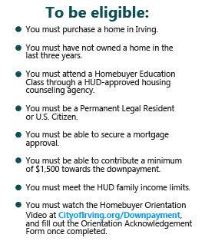
Down Payment Assistance Program
Up to $50,000 assistance
Can be used towards closing cost and down payment to purchase first home
Preferred Lenders
Work with City of Irving trained loan officers who will help you along your homeownership journey

Slide 7
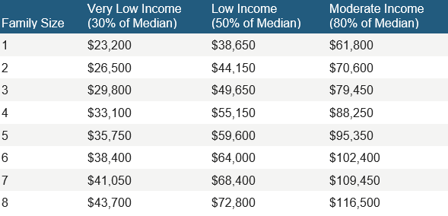
Current Dallas County Income Limits

Slide 8
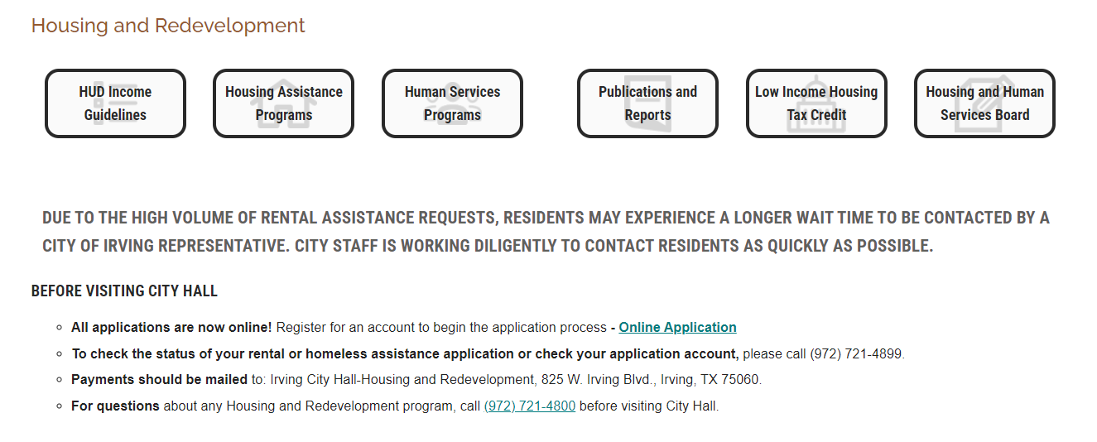
How to Apply
https://www.cityofirving.org/3468/Housing-and-Redevelopment

Slide 9
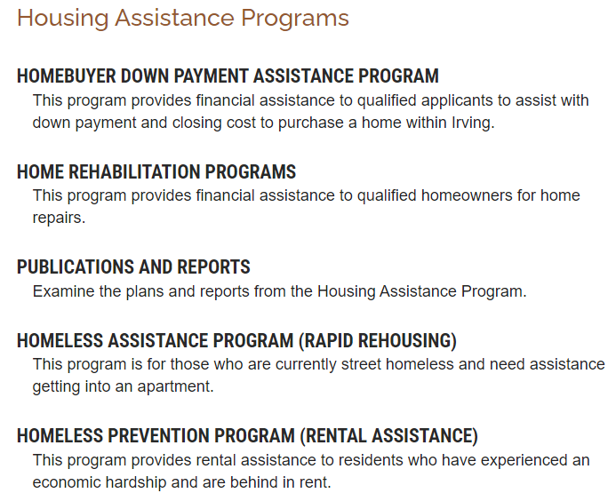
How to Apply
https://www.cityofirving.org/565/Housing-Assistance-Programs

Slide 10
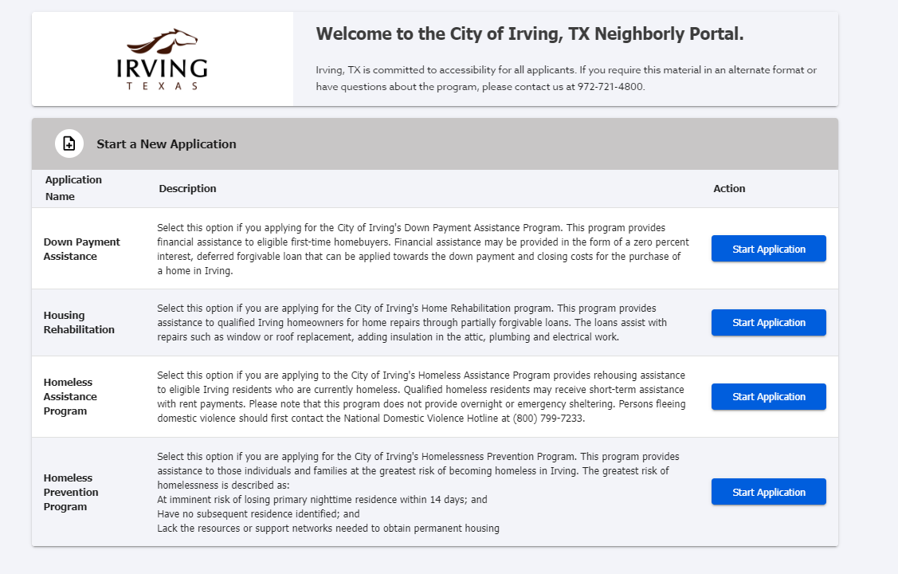

How to Apply
CityofIrving.org/HousingApplications

Slide 11
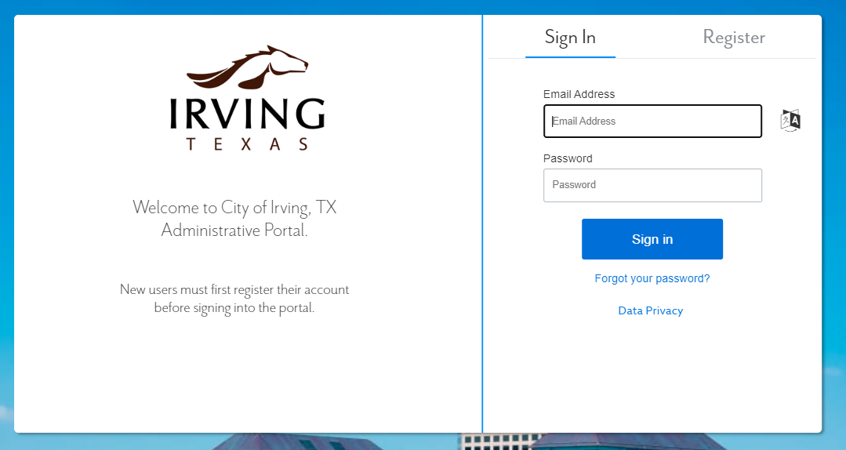
How to Apply
Register for an account.
Once registered, login to the application portal.
Select the appropriate program application.
Complete all application steps.
Upload all required documentation.
Hit submit.

Slide 12
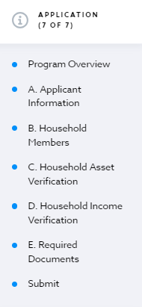
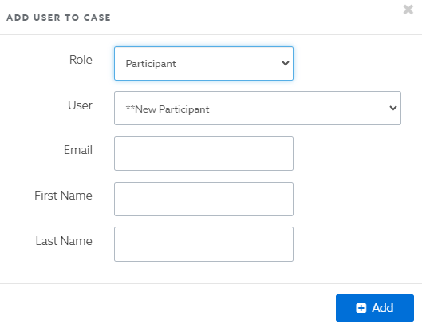
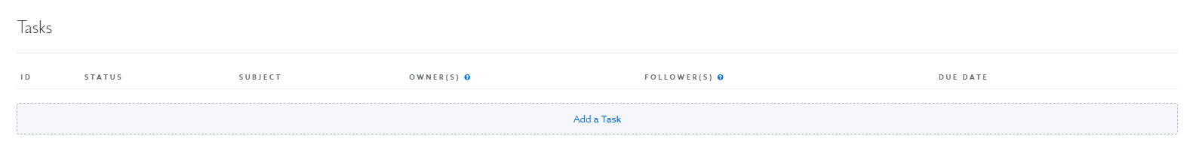
Application Tips
Read all application descriptions before starting an application
Enter all information in each application step
Upload complete and correct documentation
Add additional users
Check for emails and tasks

Slide 13
Questions?

Slide 14
Micah Sutton
Outreach Coordinator
Housing & Redevelopment Division
Msutton@cityofirving.org
972-721-4800

