Slide 1

Home Buyer Programs
Notes:
Welcome to Texas State Affordable Housing Corporation’s Home Buyer programs presentation. I am _________________ and I have been trained and certified by TSAHC to provide you with information regarding their programs. (Provide an introduction of yourself here and what you hope to accomplish by giving this training.)
Any modification to the slides must be approved by TSAHC. Please email Joniel Crim at jcrim@tsahc.org for approval.

Slide 2
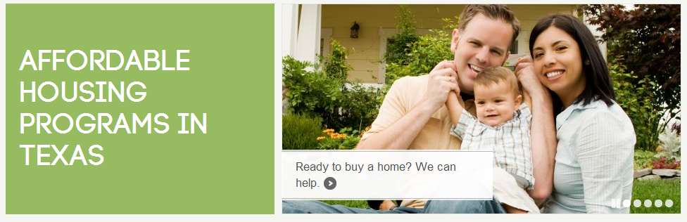
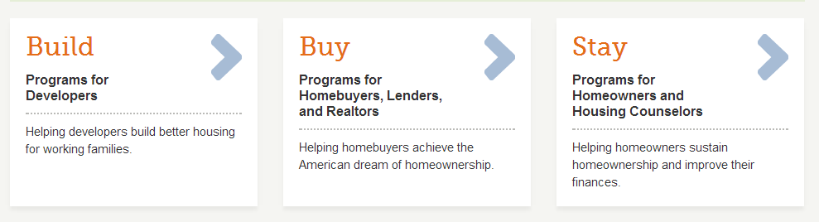
About TSAHC
TSAHC is a 501(c)3 nonprofit organization. Our mission is to serve the housing needs of low-income Texans and other underserved populations. We fulfill our mission through our concept of:
Notes:
For those of you who are not familiar with the Texas State Affordable Housing Corporation, they are a statewide non-profit created at the direction of the Texas Legislature. Their mission is to serve the housing needs of low-income and moderate income Texans.
They have several programs including home buyer programs to help individuals and families buy a home in Texas. Those programs include the Homes for Texas Heroes Home Loan Program and the Home Sweet Texas Home Loan Program. Through these programs they help almost 2000 families buy a home each year. The main difference between the two programs are the eligible professions.
The Home Sweet Texas Home Loan Program is open to anyone regardless of profession and the Homes for Texas Heroes Home Loan Program is open to teachers, veterans, police officers, corrections officers, EMS personnel and fire fighters. Both programs require the individual or family to meet certain income limits for the county they are purchasing the home.

Slide 3


Home Buyer Programs
These Home Buyer Programs offer two types of assistance to home buyers STATEWIDE.
Notes:
TSAHC offers two types of assistance to help home buyers under both the Home Sweet Texas and Homes for Texas Heroes home loan programs. This assistance is available statewide with no limitation on location.
The first type of assistance, is a low interest rate mortgage loan with down payment assistance attached to the loan. The loan is a 30 year fixed rate mortgage loan and may be an FHA, VA, USDA or Conventional mortgage loan. The assistance may be used for your down payment and to help cover your closing costs.
The second type of assistance, is a special mortgage interest income tax credit. This income tax credit will help reduce the amount of income taxes you owe the IRS by as much as $2,000 a year, every year, as long as you live in the home. By reducing the amount of income taxes you owe, this increases your take home pay which may be used to help you pay for your mortgage payment.
This tax credit may be combined with the down payment assistance too. So, not only does TSAHC help you get into your home with the down payment assistance but they also provide an income tax credit which may help you pay your monthly payments.
I will provide more detail for both types of assistance on the next slides.

Slide 4
Loans with Down Payment Assistance
Several options are available to your borrower:
Assistance % is based upon total loan amount
(i.e.: 5% of $100,000 = $5,000)
No need to be first-time buyer
(must use to purchase primary residence)
Can be used to cover down payment and/or closing costs
2% Assistance | 3% Assistance | 4% Assistance | 5% Assistance
Notes:
If you would like to participate in the Down Payment Assistance program, you will have 3 different percentage levels of down payment assistance available to you. It will be up to you to decide which assistance option you need. Your loan officer can help you decide what’s best for you . Please note that the lower the amount of assistance you choose, the lower the interest rate will be on the 30 year fixed interest rate mortgage. Check with your loan officer for interest rates.
You do have some flexibility when using the funds. You can put the money toward your down payment, closing costs, to reduce your loan balance or any combination of the three.
Also, you do not have to be a first time homebuyer to use TSAHC’s DPA program, however, it must be used to purchase your primary residence.
You may choose whichever mortgage loan type works best for you whether that’s an FHA, VA, USDA, or Conventional loan product. Your loan officer will help you with this.

Slide 5
Loans with Down Payment Assistance
Option 1: Grant | Option 2: 3-year Deferred Forgivable 2nd Lien
FHA, VA, USDA only True gift that never needs to be repaid 2%, 3% , 4% or 5% DPA options | FHA, USDA, VA or HFA Conventional Loan (HFA Preferred or HFA Advantage) 0% interest on 2nd Lien No monthly payments on 2nd Lien- Fully forgiven 3 years from closing Lower interest rates than grant 2%, 3%, 4%, or 5% DPA options
Notes:
The down payment assistance comes in two forms. The grant assistance that they receive never needs to be repaid. There are no strings attached. They don’t have to purchase in any certain areas of Texas nor do they need to stay in the property for any period of time. It is a TRUE gift.
The 3-year deferred forgivable 2nd lien is a great new option that became available on 12-2-19. This allows for someone to choose any of our loan types and any assistance level. It will provide a lower interest rate on the first lien than the grant options and it becomes a grant after 3 years.

Slide 6

Mortgage Interest Tax Credits
Mortgage Credit Certificate (MCC)
First-time buyers only
(Waived for Qualified Veterans and Targeted Areas)
Annual tax credit
Must occupy the home as principal residence
Debt-to-income ratio reduced so buying power increased
FREE for Texas Heroes using our DPA program
Notes:
The second form of assistance is my personal favorite and I like to call it the gift that keeps on giving. This special mortgage interest tax credit is called a Mortgage Credit Certificate or MCC. This is a first-time homebuyer program only, with the definition of a first-time home buyer being anyone who hasn’t had ownership interest in a primary residence for the last 3 years.
As we discussed before, an MCC gives a homeowner the ability to claim an income tax credit equal to 20% of the mortgage interest paid annually. This credit may be used every year for the life of the loan, as long as they occupy the home as their principal residence. One of the best features of an MCC, is it can help your home buyer qualify by reducing the Debt-to-income ratio on the mortgage loan, which gives your home buyer more buying power!
Remember, this tax credit may be combined with TSAHC’s down payment assistance at the same time. Plus, its free for Texas Heroes who are also using TSAHC’s down payment assistance!
(Feel free to add personal testimonials regarding the Mortgage Credit Certificate program)

Slide 7
Mortgage Interest Tax Credits
Equal to 15% of the mortgage interest paid every year.
Credit Example
Loan Amount $320,000
Interest Rate x 7.625%
Interest Paid in 1st Full Year $24,400
15%=$3,660
No $2,000 max on credit earned!
Effectively lowers their interest rate to 6.481%!!
Lender may also add the $3,660 as income on loan applications!!
That’s up to $305 a month in additional income!!
That’s also $74,305 credited back over 30 years!!

Slide 8

Mortgage Interest Tax Credits
What’s the difference between a tax credit
and a tax deduction?
  Tax Credits = Reduction of tax liability
  or taxes owed
  Tax Deductions = Reduction of taxable income
Notes:
Some folks may be thinking that, everyone benefits from mortgage interest on your income taxes so why do I need an MCC? This is true but only holders of an MCC benefit from the dollar for dollar credit that an MCC provides.
What’s the difference between a tax credit and a tax deduction? Tax credits provide a dollar-for-dollar reduction of income tax liability or taxes owed, while tax deductions allow one to lower the amount of taxable income by the amount of the mortgage interest. As an example, if you pay $5,000 in mortgage interest and your income is $50,000, you can reduce the amount of your taxable income by the amount of interest you paid, which would reduce your taxable income to $45,000. This is the amount of income you will pay income taxes on. A $2,000 deduction, for example, might reduce your tax bill by only $300 to $400. A $2,000 tax credit cuts your tax bill by $2,000.

Slide 9
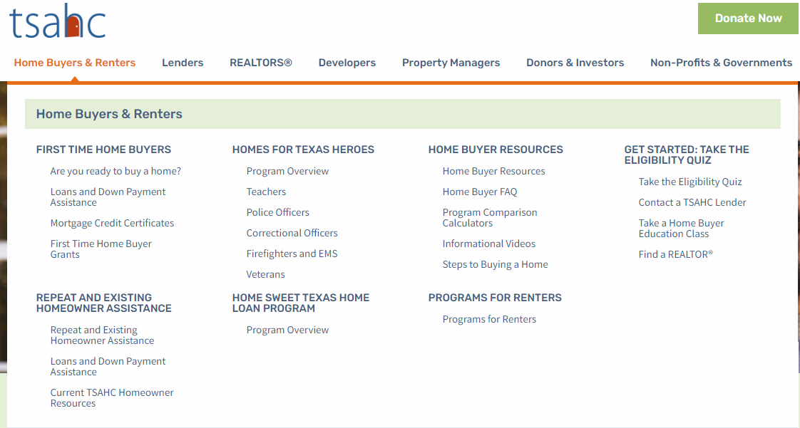
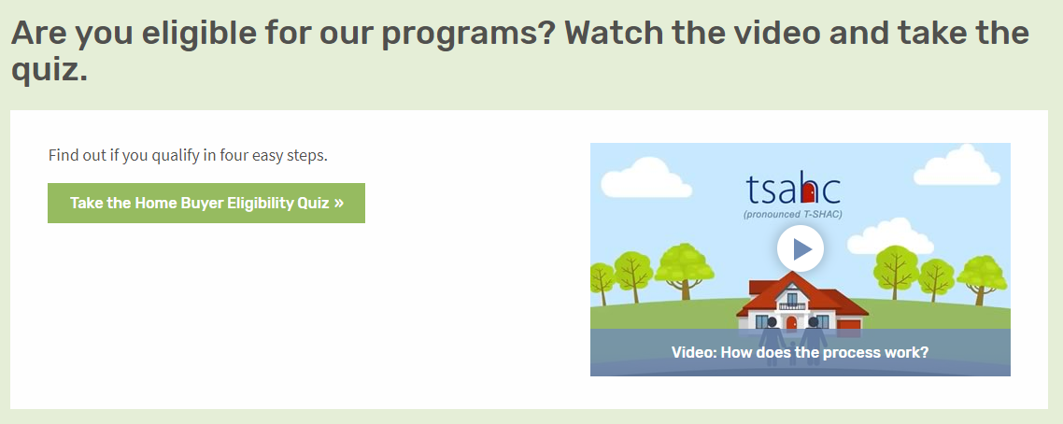
How to Get Started
Visit www.ReadyToBuyATexasHome.com to take the following steps:
1. Take the Eligibility Quiz
Notes:
LOAN OFFICERS: Slides 12-14 may be modified to promote you and your company.
REALTORS: Slides 12-14 may be modified to promote your preferred loan officer.
Any modification to the slides must be approved by TSAHC. Please email Joniel Crim at jcrim@tsahc.org for approval.
So how do you determine if you can use one or both of these programs?
First, visit www.ReadyToBuyATexasHome.com.
Click on the “Home Buyers & Renters” tab at the top of the page.
You will see ‘Take the Eligibility Quiz’.
This will walk you through the eligibility criteria with 4 easy questions.
Should you not see your job title listed, no worries! Just choose “my job title is not listed”.
You can also watch a short video about the programs!

Slide 10
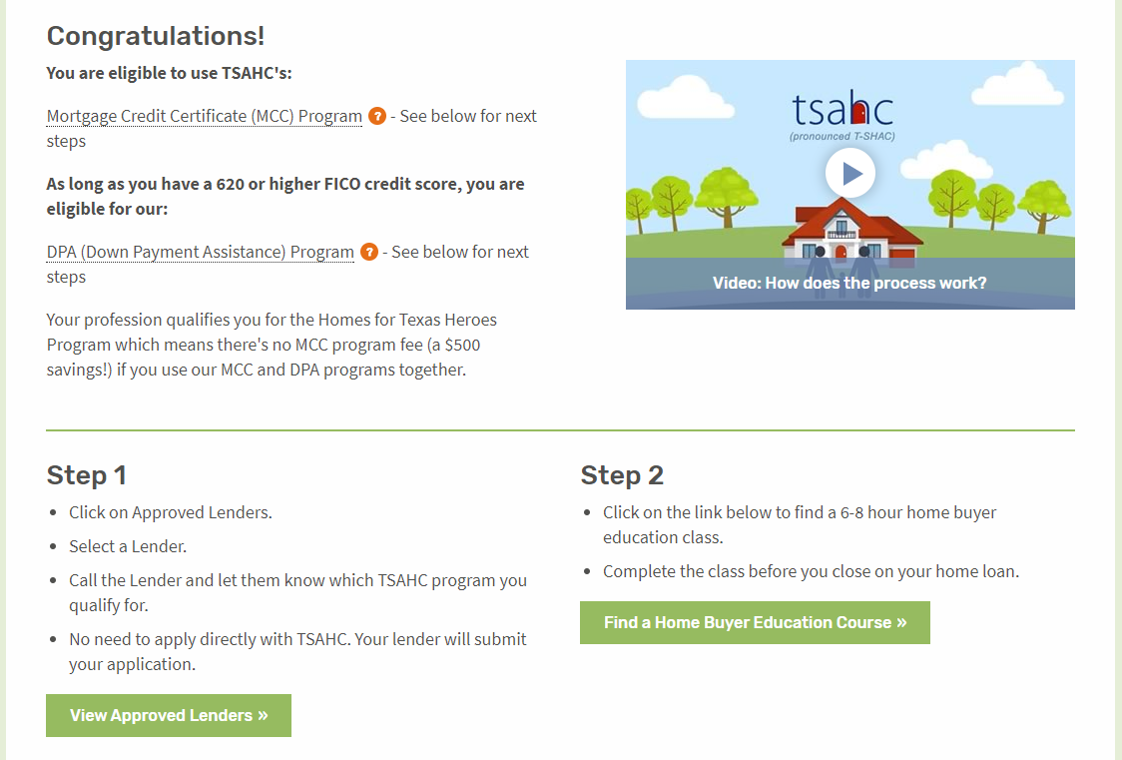
How to Get Started
Visit www.ReadyToBuyATexasHome.com to take the following steps:
2. Carefully read your quiz results for additional details and next steps.
Notes:
LOAN OFFICERS: Slides may be modified to promote you and your company.
REALTORS: Slides may be modified to promote your preferred loan officer.
Any modification to the slides must be approved by TSAHC. Please email Joniel Crim at jcrim@tsahc.org for approval.
Next, should you qualify, your quiz results will tell you what your next steps will be in order to move forward. Please note that for the Down Payment Assistance program, certain credit scores and debt to income ratios are required. To learn more about them, click on the link provided.
Step 1:
You will need to contact a preferred loan officer by clicking on the “View Lenders In Your Area” button. Choose a preferred loan officer from the list.
Then, simply inform the loan officer that you would like to use one or both of TSAHC’s programs. The loan officer will walk you through the remainder of the process, ensuring that you qualify and will also submit an application for the assistance on your behalf. No direct application to TSAHC is required. Everything is done by the loan officer.
Step 2:
Before closing on your home, you will need to complete a homebuyer education class. This class is extremely beneficial to you as a homeowner and will teach you all about the home buying process. You can find one in your area or online by clicking on the “Find a Home Buyer Education Course” button.

Slide 11
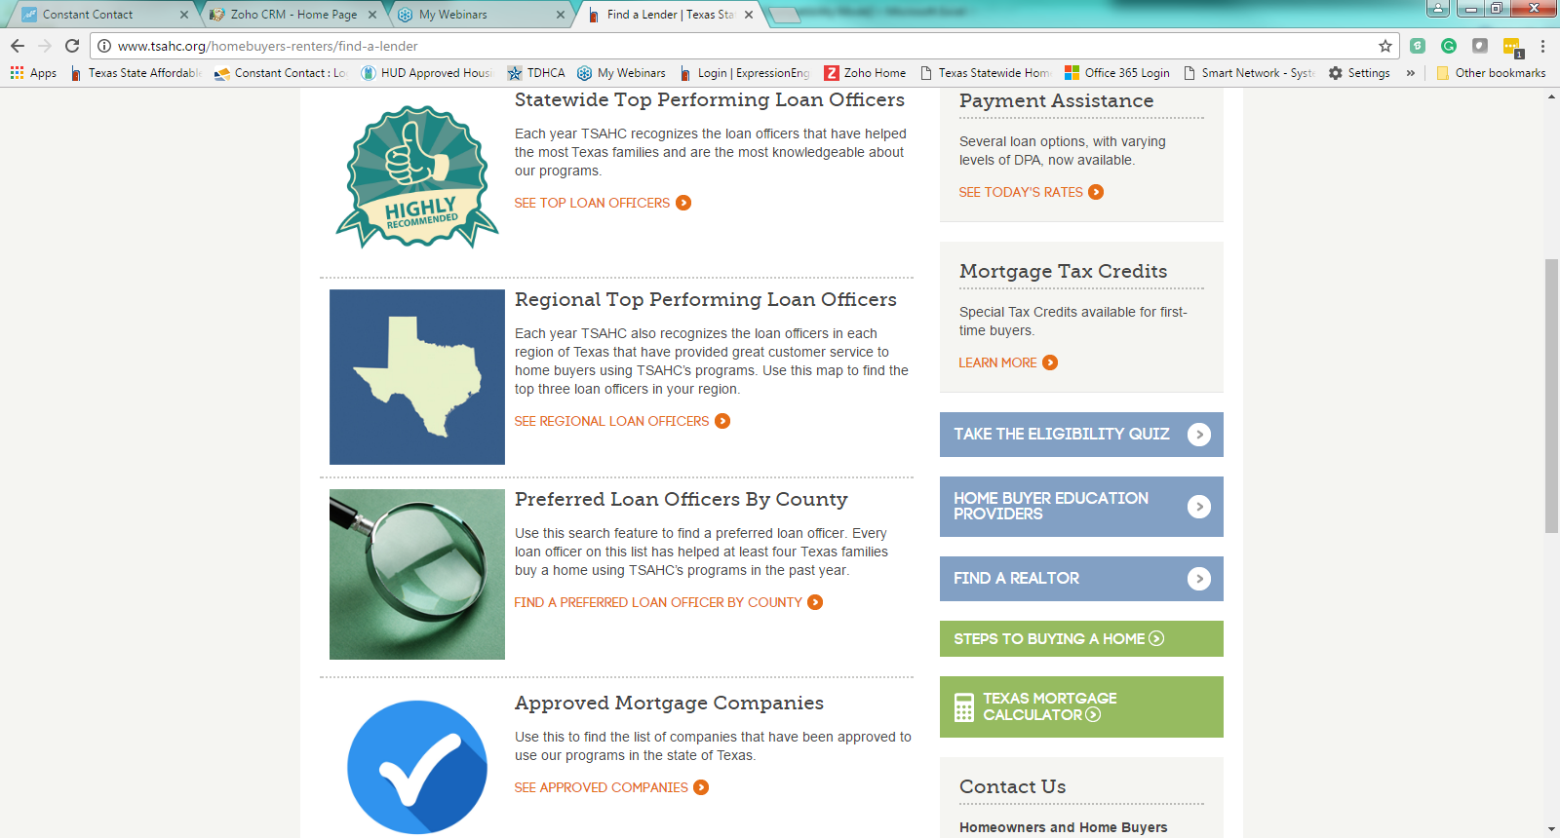
How to Get Started
Visit www.ReadyToBuyATexasHome.com to take the following steps:
3. Contact an Approved Lender to Apply.
Notes:
LOAN OFFICERS: Slides 12-14 may be modified to promote you and your company.
REALTORS: Slides 12-14 may be modified to promote your preferred loan officer.
Any modification to the slides must be approved by TSAHC. Please email Joniel Crim at jcrim@tsahc.org for approval.
When choosing a loan officer, know that TSAHC highlights loan officers who are knowledgeable and experienced in both the DPA and MCC programs.
The “Statewide Top Performing” section highlights loan officers who have done the most business with TSAHC statewide. Because of their extensive use of both the MCC and DPA programs, they are very knowledgeable about the process - providing a sense of confidence that a home buyer will have a good experience using either of TSAHC’s programs when working with them.
The same applies to the “Regional Top Performing Loan Officers” section that highlights loan officers who have done the most business with TSAHC in their particular region of Texas.
Also, in the “Preferred Loan Officers by County” section, you can find a list of loan officers that are approved in your county. These folks have helped at least four families use our programs in the past year.
And finally, the “Approved Mortgage Companies” section will help you see the companies that have been approved to use our programs in the state of Texas. Any loan officer working for one of these companies may help you purchase a home using TSAHC’s programs. If the loan officer is not yet familiar with TSAHC’s programs, simply put them in touch with TSAHC.

Slide 12
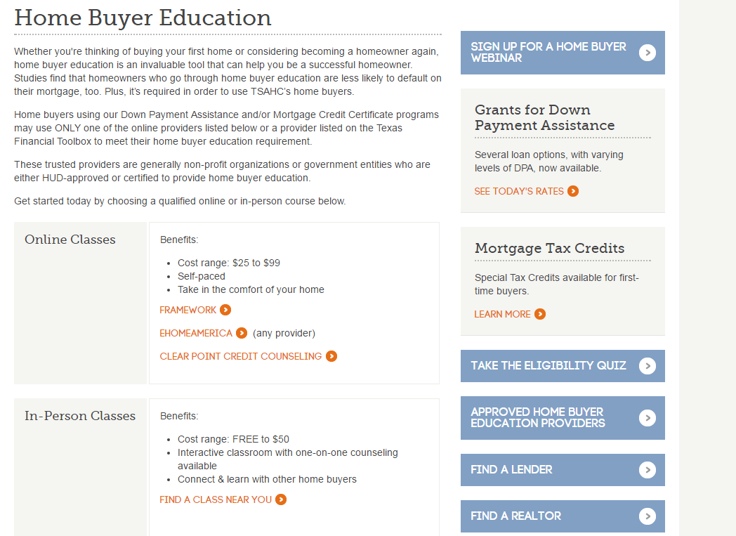
How to Get Started
Visit www.ReadyToBuyATexasHome.com to take the following steps:
4. Take a Home Buyer Education Course (Online or In Person)
Notes:
Home buyers need to complete a homebuyer education course prior to closing on the home loan.
When choosing a Home Buyer Education class, you have the option of taking an “Online Class” or an “In-Person Class”. The 3 online options that TSAHC allows are listed in the “Online Classes” section. Please just choose one to take and that will suffice. Should you like an “In-Person” class, you can find one near you by clicking on the “Find a Class Near You” button.

Slide 13


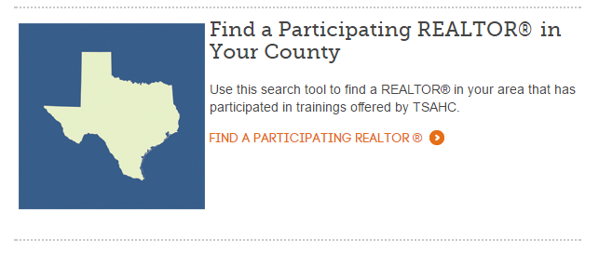
How to Get Started
Visit www.ReadyToBuyATexasHome.com to take the following steps:
5. Find a Participating Realtor
Notes:
LOAN OFFICERS: Slide 16 may be modified and additional slides added to promote your preferred Realtor.
REALTORS: Slide 16 may be modified and additional slides added to promote you and your company.
Any modification to the slides must be approved by TSAHC. Please email Joniel Crim at jcrim@tsahc.org for approval.
TSAHC does not require you to work with a REALTOR® that has been approved by TSAHC. However, if you are looking for a REALTOR®, TSAHC offers several resources to help you find one familiar with TSAHC’s down payment assistance and mortgage tax credit programs. Use this search tool to find a REALTOR® in your area that has participated in trainings offered by TSAHC.

Slide 14
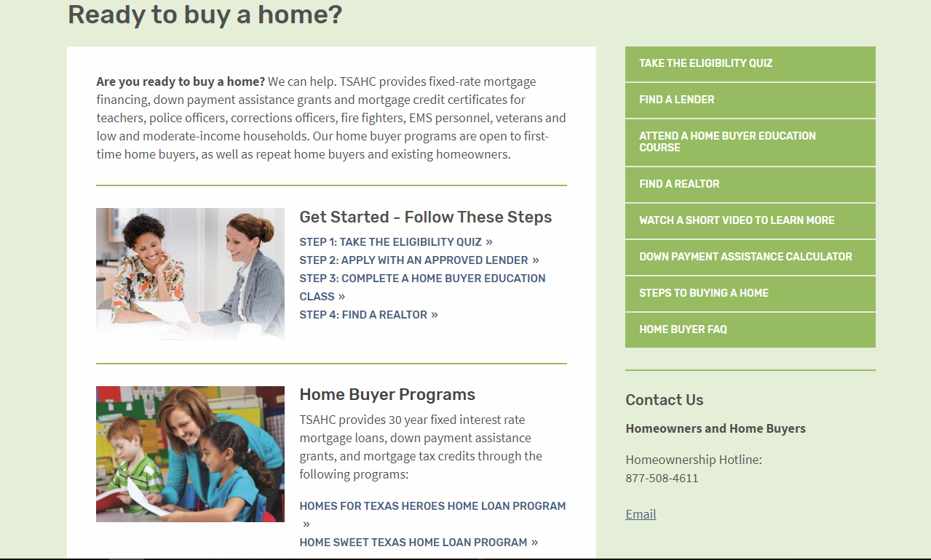
www.ReadyToBuyATexasHome.com
Notes:
Again, when visiting the Home Buyers and Renters section of www.ReadyToBuyATexasHome.com, you will find:
The Eligibility Quiz
Information for the Loans with Down Payment Assistance program
More information about the Mortgage Credit Certificate program
Many consumer resources including a “Steps to Buying a Home” page and webinar and the Texas Mortgage Calculator

Slide 15
Other DPA Programs Locally
City | Program | Information
Arlington | Arlington Homebuyers’ Assistance Program | Downpayment and closing cost assistance is provided in the form of a forgivable loan of up to $20,000 based on each applicant’s underwriting and subsidy layering assessment. The loan is 0% interest and is payable only if you sell, refinance with cash-out, or lease your home during the affordability period, typically five years.
Dallas | Housing Choice Voucher- Dallas Housing Authority | Use Voucher toward purchase of a home vs. using it for rent
Dallas | Dallas Homebuyer Assistance Program (DHAP) – City of Dallas | Check for funding allocations
Notes:
No need to go over details just that the programs do exist and for them to do their own research!

Slide 16
Other DPA Programs Locally
City | Program | Information
Denton | Home Buyer Assistance | The City of Denton helps low-and-moderate-income families with the down payment assistance and closing costs to buy their first home. Assistance is in the form of a forgivable loan at 0% interest for five years.
Fort Worth | Home buyer assistance program – city Neighborhood services department | The city’s Homebuyer Assistance Program (HAP) can provide up to $25,000 in mortgage assistance for income-eligible first-time homebuyers within the Fort Worth city limits. Maximum sales price for an existing unit is $290,000 and new construction is $305,000 as of July 2023.
Frisco | City of Frisco DPA program | Families with at least one adult working full-time for the City of Frisco or Frisco ISD for at least 6 months may be assisted in purchasing a home in Frisco. The program provides forgivable loans of up to $10,000 to qualified homebuyers for the purpose of down payment and closing cost assistance

Slide 17
Other DPA Programs Locally
City | Program | Information
Grand Prairie | Buyer Power Program | The Buying Power Program assists first time home-buyers who are low-to-moderate income persons and families in purchasing a home with grant funds for down payment or closing cost assistance. This program is administered through the Housing and Neighborhood Services Department of the City of Grand Prairie.
Irving | City of Irving DPA program | Funded by the U.S. Department of Housing and Urban Development, this program provides financial assistance to qualified applicants in the form of a zero percent interest, deferred forgivable loan. The funds can be applied to down payment and closing costs to purchase a home within the City of Irving.
Plano | City of Plano | Down Payment assistance – details on website

Slide 18

Questions
Notes:
I want to thank you for your time today. I hope you are excited about the opportunity these programs may provide you to become a homeowner. I’m happy to answer any questions you might have for me now. If you have further questions, feel free to contact me with the following contact information. Should you want to talk to TSAHC directly, they may be contacted at the homeownership hotline, (877) 508-4611 or you may email them at Homeownership@tsahc.org.

