Slide 1


Dallas Habitat’s Homebuyer Assistance
Melissa Garza
Mortgage Portfolio Manager
Dallas Area Habitat for Humanity

Slide 2
About Dallas Habitat
Dallas Habitat supports first-time home buyers through:
Homeownership Counseling
  One-on-one, personalized coaching to help buyers prepare for homeownership. Buyers meet with a HUD-certified Counselor to identify obstacles to homeownership, develop/attain financial goals, and become “Mortgage Ready”.
Homebuyer + Financial Education
  Open to anyone, anywhere. All resources available online and most courses offered at no-cost.
Affordable Homeownership Program
  Dallas Habitat builds ~roughly 20 homes/year available to those who meet qualification criteria. Through affordable financing and down payment assistance, Habitat homeowners maintain long-term housing affordability.

Slide 3
Who Qualifies for Habitat’s Financial Assistance?
To qualify for Dallas Habitat’s financial assistance, buyers must:
Complete Homeownership Counseling and become “Mortgage-Ready”
  Mortgage-Ready means demonstrating stable income, a good credit history with a score of 620+, at least $3,000 saved for upfront costs, and completion of pre-purchase education.
Earn ≤ 80% Area Median Income
Meet Habitat’s loan qualification criteria
Choose to buy a Dallas Habitat home
80% AMI Income Limits *Note: These are not the income guidelines for counseling
Household Size | 1 | 2 | 3 | 4 | 5 | 6 | 7 | 8 | 9
Max Income | $61,800 | $70,600 | $79,450 | $88,250 | $95,350 | $102,400 | $109,450 | $116,500 | $123,550
Notes:
Counseling towards Mortgage-Readiness: Discuss how counseling helps prepare buyers – whether they choose to buy with Habitat or not. Emphasize that counseling is a pre-requisite for buying a Habitat home.
80% AMI: Clarify that Habitat counsels clients above this income limit, but in order to buy a Habitat home, clients must be at/under 80%
Loan Criteria: Buyers must meet loan underwriting criteria required for pre-approval and be able to afford available Habitat inventory
Buy a Habitat home: Must choose to buy an available Habitat home (locations and neighborhoods vary). Feel free to name our priority communities, i.e. West Dallas, Southeast Oak Cliff and Bonton/Ideal.

Slide 4
Types of Financial Assistance
For those who qualify, Dallas Habitat provides:
0% interest rate mortgage (30 year fixed)
$8,000 in Down Payment Assistance. No additional financial down payment required (“Partnership Hours” completed in lieu).
In-house closing cost assistance
Ability to stack other approved funding sources, as funds are available (i.e. FHLB HELP)
On average, Dallas Habitat mortgage payments range from $950 – $1,200/month (including taxes & insurance)
Notes:
0% interest means that you build more wealth (equity) starting with your very 1st mortgage payment – unlike interest-bearing loans, in which your first few years go almost entirely to interest vs. principal.
$8K in DPA is
Closing Cost assistance amount can vary. Buyers must contribute $2,000 towards closing costs out of pocket.
Other approved sources of DPA/CC Assistance include FHLB HELP and LIFT funds, as available.

Slide 5
Additional Support
Did you know?
Dallas Habitat can help connect you with DPA programs, even if you don’t buy a Habitat home!
Our Homeownership Counselors are unbiased housing advocates for YOU!
Our team is well-versed in all of the programs featured today. We can help connect you with trusted, affordable loan products, home buying professionals and assistance programs, whether you choose to buy with Habitat or on the open market!

Slide 6
Resources
Pre-Screen Tool for Counseling Program: www.dallasareahabitat.org/home-counseling/
Homebuyer and Financial Education: www.dallasareahabitat.org/education/
PocketWise (self-guided financial tools): https://dallasareahabitat.everfi-next.net/welcome/achieve
Dallas Habitat’s services and programs are digital-first and are currently being offered 100% online
Notes:
Use our pre-screen tool to determine if our program is a good fit for you at this time. To access the tool, visit our website or use the link shown here.
A reminder that all of our homebuyer and financial education is open to everyone! You do not need to be participating in our program to access these great resources. Simply visit our website or use the direct link here to learn more.
PocketWise is Dallas Habitat’s free online platform of financial tools and resources. This platform is a great way to learn how to become financially savvy!

Slide 7
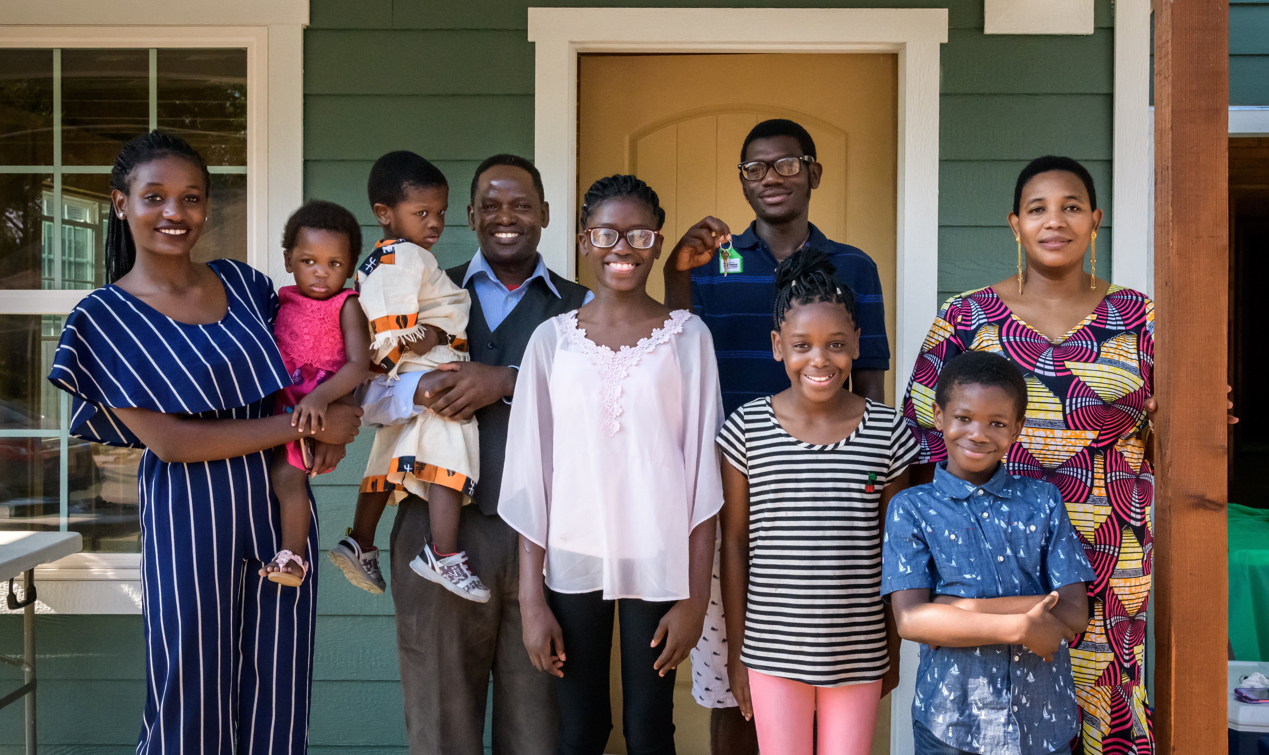
Thank You!
For more information, visit:
dallasareahabitat.org

