Slide 1
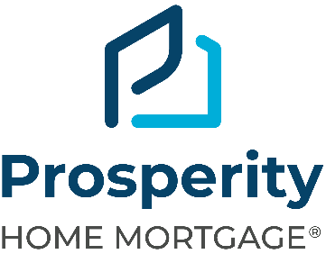
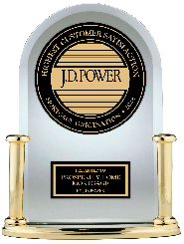
Affordable Lending Solutions
Rated # 1 in Customer Satisfaction by JD Power among Mortgage Origination Companies

Slide 2

What is Affordable Lending?
Affordable lending allows borrowers who may not qualify for a loan under conventional circumstances the opportunity to become a homeowner.
Affordable Lending Benefits:
More loan options
More down payment assistance options
More affordable payment options
More opportunities to qualify & build wealth

Slide 3
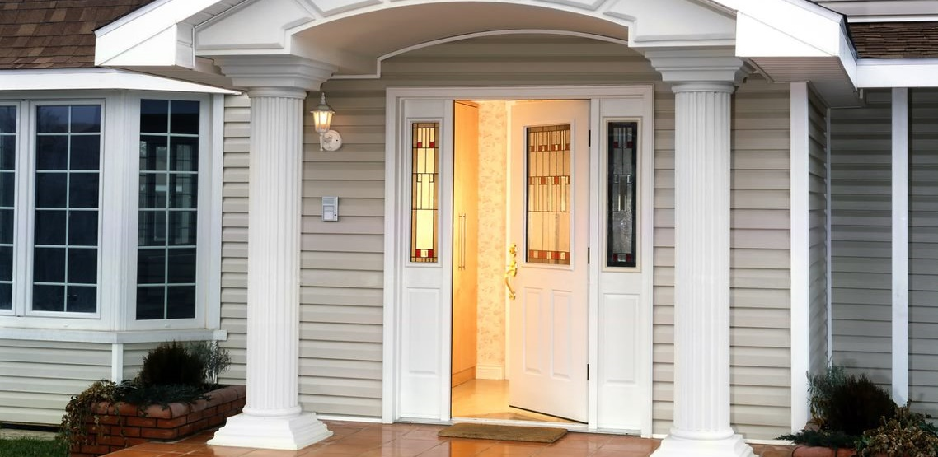
Welcome Home
Zero-Down Combo Loan!
Combine a 1st and 2nd mortgage for a home loan that offers no-money-down and no mortgage insurance (MI)
Open Door offers a 3% down payment 1st mortgage option, plus a down payment assistance 2nd mortgage for up to 4% that may be used to cover down payment and/or closing costs.
Features:
No down payment required
No mortgage insurance
1st mortgage up to $806,500 ($1,209,750 maximum loan amount is available in high balance areas. Contact your mortgage consultant for details.)
2nd mortgage is an interest-only, 30 year loan at the same interest rate as the first mortgage
30 year fixed rate only
Purchase and rate-term refinance options available

Slide 4
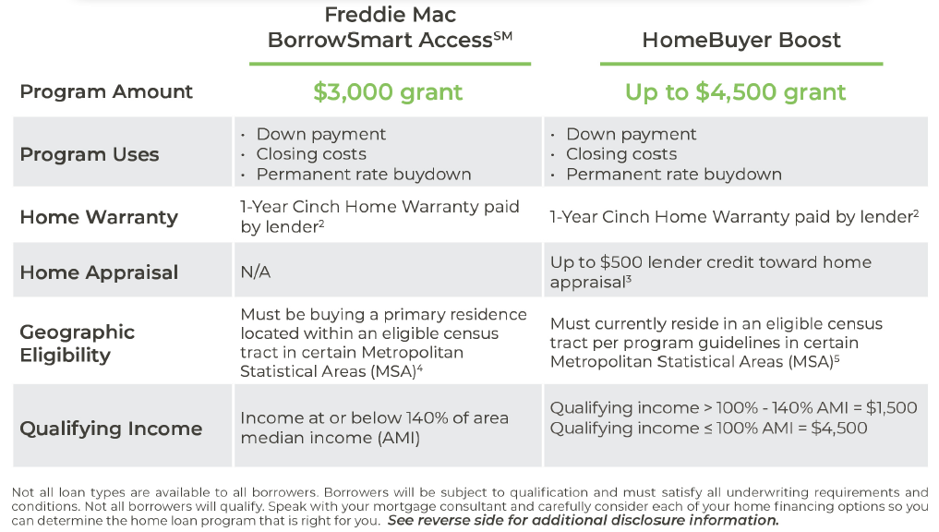
Special Homebuying Grants

Slide 5
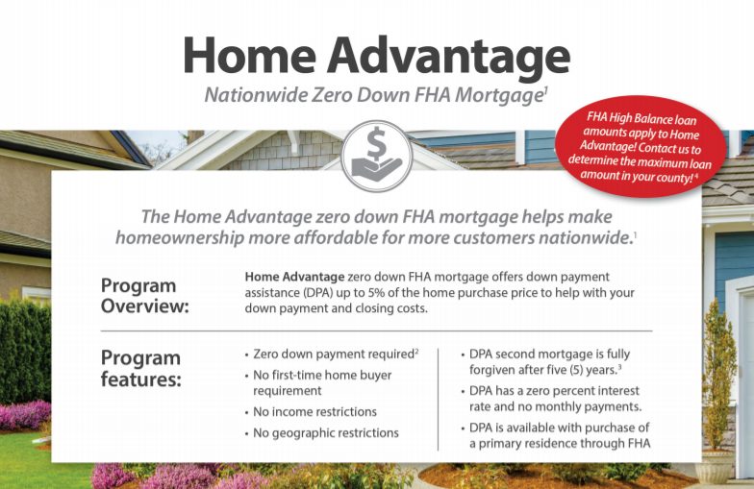
FHA Loans
Features
Available in a variety of fixed-rate and adjustable-rate loan options.
May allow you to use a gift or grant for all or a portion of your closing costs.
Current FHA homeowners may be able to obtain an FHA streamline refinance.
You typically have to pay upfront and monthly FHA Mortgage Insurance premium.
Benefits
Requires less cash upfront for your down payment and closing costs.
Available for all income levels.
Allows a new buyer to take over the loan if you sell your home (subject to loan approval).
Provides reduced paperwork if you're eligible for an FHA Streamline Refinance.
A co-applicant can help you qualify even though they do not live in the home.
FHA (Federal Housing Administration) loans are designed to make housing more affordable, particularly for first time homebuyers.
FHA loans typically permit borrowers to buy a home with a lower down payment than conventional loans. These loans must meet certain criteria.

Slide 6

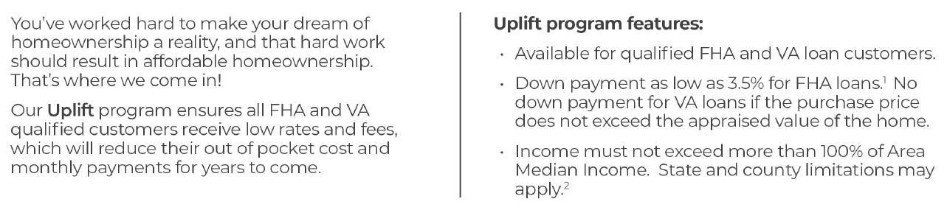
Uplift

Slide 7

What is a VA loan?
A loan backed by the Department of Veterans Affairs, which help Veterans, service members, and their survivors to buy, build, improve, or refinance a home. You’ll still need to have the required credit and income for the loan amount you want to borrow, but a VA home loan may offer better terms than a conventional loan.

Slide 8

VA Home Loan Advantage
We Take Care of Our Veterans!
No Down Payment
No Origination fee EVER ($1665 value)!
Our Lowest Rates EVERY DAY!

Slide 9
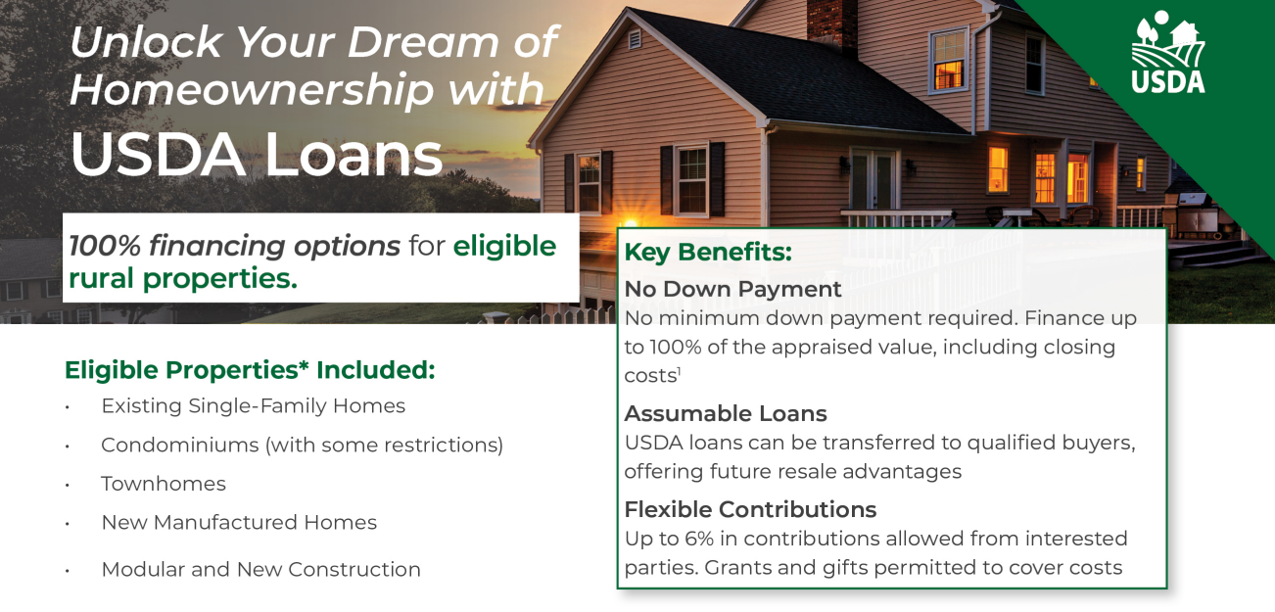
Establish New Markets
1. Eligible only for single family, primary residences purchased within the eligible rural areas as defined by the USDA. Credit is subject to approval. Property location, asset and income restrictions apply, and home buyer education may be required.
2. A guarantee fee is charged and collected at the time of closing and can be paid by the buyer or seller, or financed. Loan amounts may exceed the appraised value of the property (e.g. >100% LTV) to include the amount of a financed guarantee fee. This applies only to loans for which all or a portion of the guarantee fee is being financed into the loan. Information is accurate as of date of printing and subject to change without notice.

Slide 10
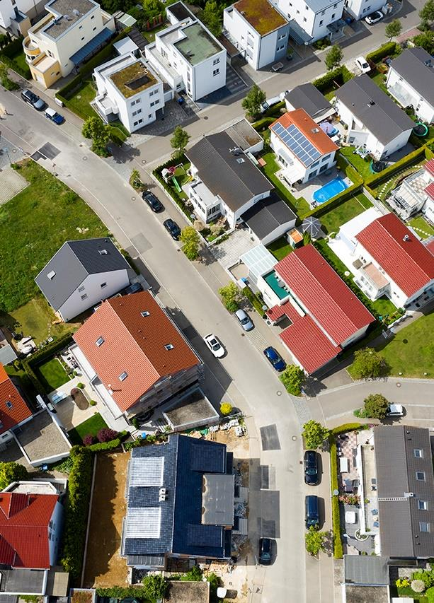
Bond Programs/MCCs
Bond loans are issued by state and local governments market and help home buyers with low and moderate incomes buy their first homes.
The Mortgage Credit Certificate (MCC) program provides affordable homeownership benefits for qualified households through a federal income tax credit. MCCs entitle eligible Consumers to a direct credit against their federal income tax liability.
Bond and MCC programs are for borrowers that don’t have a lot of money saved up for downpayment and closing cost!
Programs vary in each market and are not available everywhere. Consult your Mortgage Consultant for more information.

Slide 11

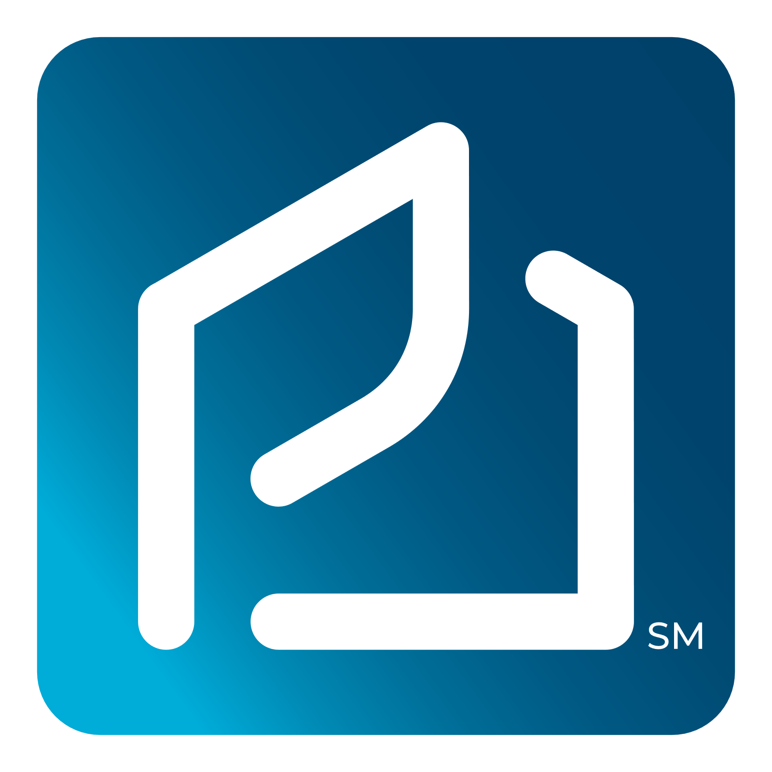


HomeSURE Advantage!!
$30,000 On Time Closing Guarantee!!
REFIne Your Rate!!
Win in Multiple Offer Scenarios
Better Experience
Expedited Mortgage Loan Process

Slide 12
Exclusive HomeSURE Advantage
Secure Financing Upfront
  Get the hard part out of the way upfront.
  No wasting time or last-minute surprises.
  Complimentary option to lock rate upfront before finding a home.
Underwritten Loan Commitment
  Signed by an underwriter not a loan officer
  Verified income, assets and credit. Not a pre-qualification.
Ready to Buy Today!
  Worry less about the mortgage.
  Consider no financing contingency.
Expedited Closing Path
  Prioritized for an on-time closing.

Slide 13

$30,000 Close On-Time Guarantee
We’re so CONFIDENT in our HomeSURE Advantage
we put our money where our mouth is!
PHM Will Close
On-Time or Pay the SELLER
$15,000
PHM Will Close
On-Time or Pay the LISTING BROKERAGE
$15,000

Slide 14
Let Us Help You Prosper…..
More Loan Options
More Down Payment Assistant Options
More Affordable Payment Options
More Opportunities To Qualify & Build Wealth

Slide 15
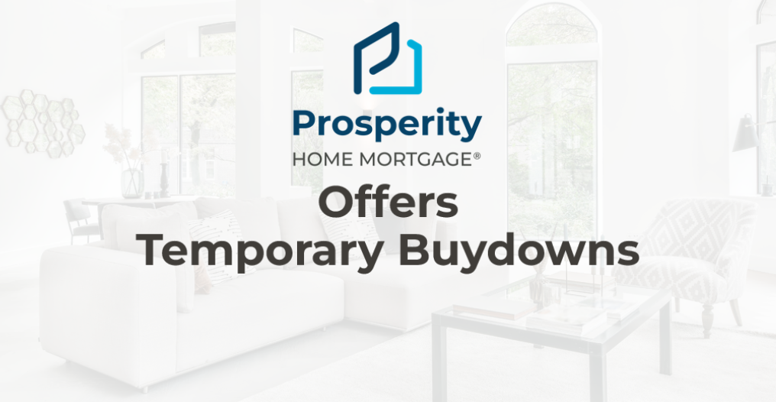

Slide 16
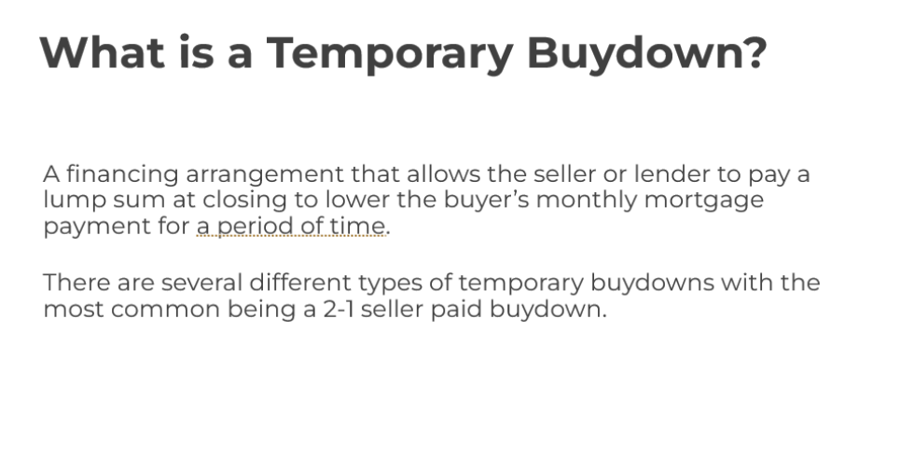

Slide 17
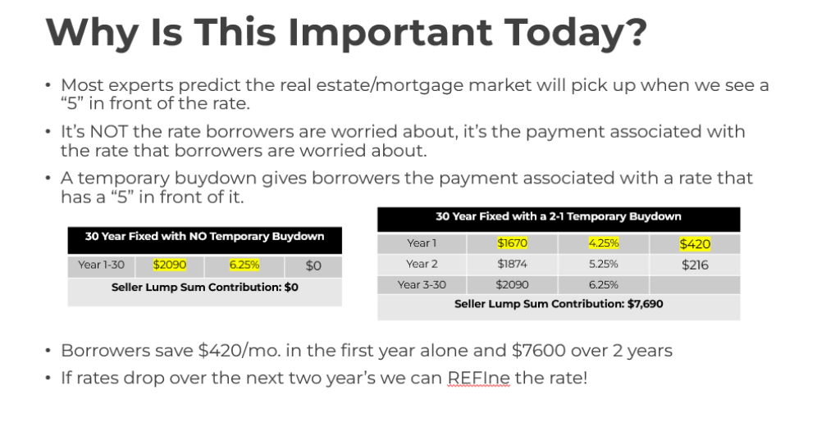

Slide 18
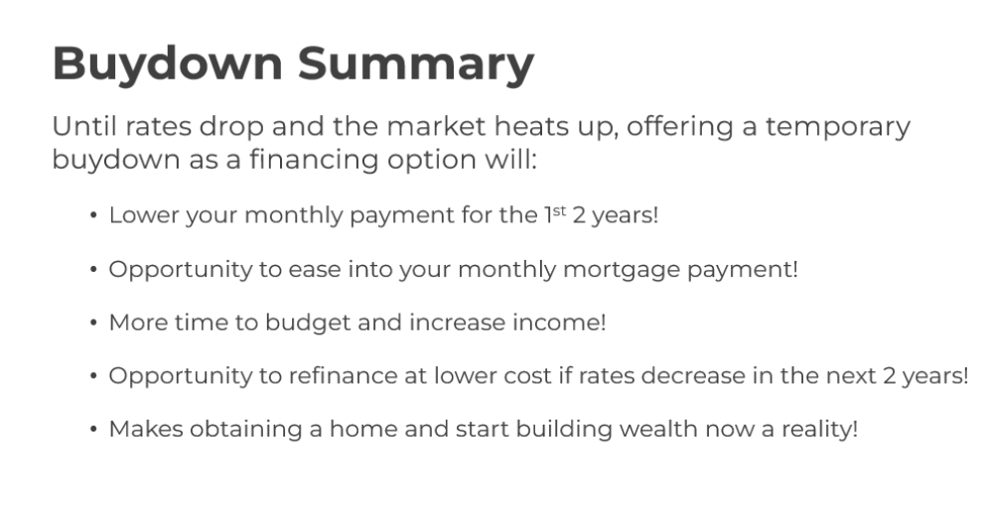

Slide 19
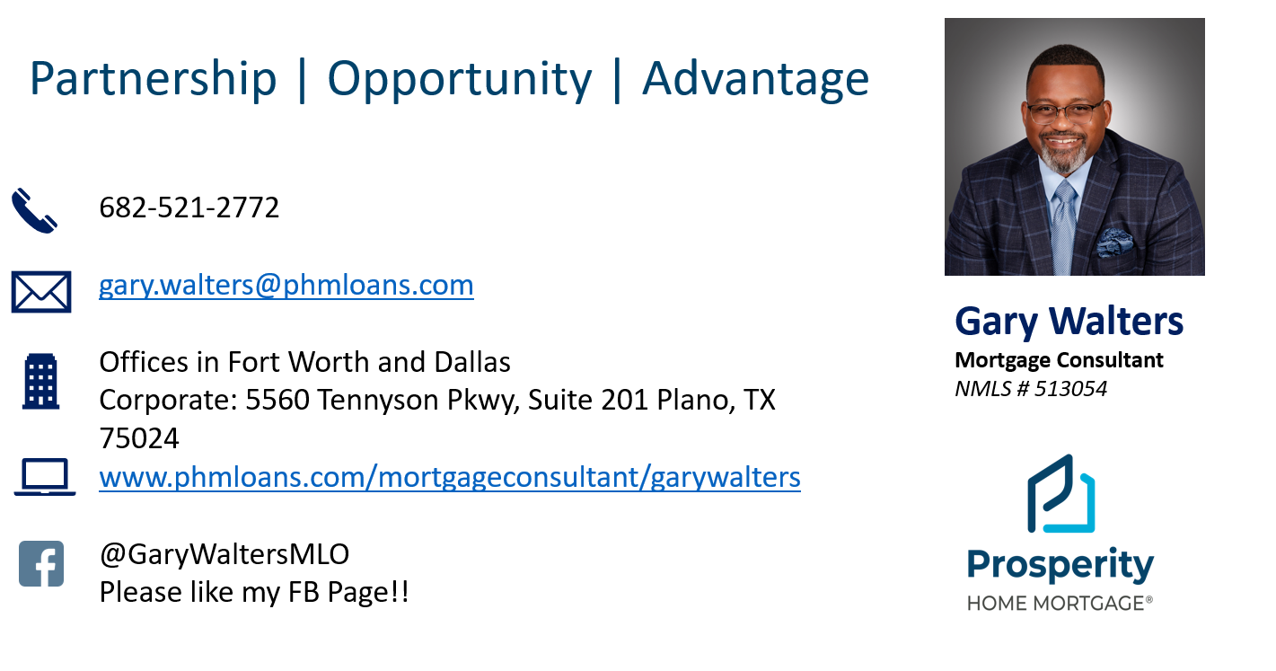
Any Questions?

