Slide 1



Texas Department of Housing and Community Affairs
Down Payment Assistance
Presented by the Texas Homebuyer Team
Texas Department Of Housing and Community Affairs
www.TheTexasHomebuyerProgram.com

Slide 2


HOW THE PROCESS WORKS
TDHCA’S FIRST MISSION IS TO PROVIDE IMPORTANT GUIDANCE TO HOMEBUYERS. OFTEN CHALLENGES TO A HOMEBUYER BEING READY TO PURHCASE A HOME NEED TO BE OVERCOME. HELPING TO FIND RESOURCES IS A CRITICAL, FIRST STEP.
1
REVIEW YOUR FINANCIAL SITUATION AND DETERMINE IF YOU ARE IN NEED OF DOWN PAYMENT AND CLOSING COST ASSISTANCE.
2
LOCATE A TDHCA APPROVED MORTGAGE LENDER
HTTPS://THETEXASHOMEBUYERPROGRAM.COM/LENDERS/APPROVED-LENDERS

Slide 3

HOW THE PROCESS WORKS
3
COMPLETE A HOMEBUYER EDUCATION COURSE. THIS CAN BE DONE BEFORE APPLYING BUT MUST BE DONE BEFORE CLOSING.
4
YOUR APPROVED LENDER FOR THE TEXAS HOMEBUYER PROGRAM WILL PREQUALIFY YOU AND INCLUDE THE TDHCA DOWN PAYMENT AND CLOSING COST ASSISTANCE TO PIGGY BACK ON THE FIRST LIEN PRE-APPROVAL. NO UPFRONT REVIEW REQUIRED!

Slide 4


HOW THE PROCESS WORKS
5
YOUR LENDER WILL MAKE A RESERVATION IN TDHCA SYSTEM FOR THE DPA FUNDS AND LOCK IN THE INTEREST RATE. THE THDCA PROCESS TAKES NO ADDITIONAL TIME TO CLOSE AND IS DONE AS A PART OF YOUR REGULAR MORTGAGE LOAN PROCESS BY YOUR LENDER.
6
ONCE THE LOAN IS APPROVED, YOUR LENDER SCHEDULES CLOSING. CELEBRATE! YOU HAVE ACHIEVED THE DREAM OF HOMEOWNERSHIP, WITH A LITTLE HELP FROM YOUR FRIENDS AT TDHCA!

Slide 5





  FHA, VA, USDA
  First Time Homebuyer Requirement (waived for qualified Veterans and Targeted Areas)
  Income and Purchase Price Limits Apply
  FHA, VA, USDA, Conventional (FNMA HFA Preferred/FHLMC HFA Advantage)
  No First Time Homebuyer Requirement
  No Purchase Price Limits
  2-5% Assistance based upon the total loan amount
  Can be used for Down Payment or Closing Costs
  Fixed interest rate determined by the DPA assistance amount
  Pre-Purchase Homebuyer Education Required
  Program is available Statewide
Eligible Property Types:
  New or existing SINGLE-FAMILY residences
  Duplexes as long as one unit is occupied by the owner as primary residence
  Condominiums
  Manufactured homes (must be real property by the time of loan purchase)

Slide 6

DOWN PAYMENT / CLOSING COST ASSISTANCE OPTIONS:
PROVIDED IN THE FORM OF A:
DEFERRED REPAYABLE 30 YEAR 2ND LOAN OPTION
OR
3 YEAR FORGIVABLE 2ND LOAN OPTION
NO REQUIRED MONTHLY PAYMENT (LENDER WILL NOT CONSIDER THIS AS ADDITIONAL DEBT IN LOAN QUALIFYING). BORROWERS DO HAVE THE OPTION TO MAKE VOLUNTARY PAYMENTS AT THEIR DISCRETION.
NO INTEREST – 0% 2ND LOAN
  DUE UPON SALE, PAYOFF OR REFINANCE OF THE 1ST LIEN MORTGAGE FOR REPAYABLE OPTION
  OR BEFORE 3 YEARS IF EXERCISING THE FORGIVABLE ASSISTANCE LOAN

Slide 7

DOWN PAYMENT / CLOSING COST ASSISTANCE OPTIONS:
NO DPA UN - ASSISTED LOAN OPTION
GREAT OPTION FOR YOU MORE HIGHLY QUALIFIED, HOMEBUYERS WHO HAVE YOUR OWN DOWN PAYMENT RESOURCES AND ONLY NEED A LOWER MORTGAGE RATE AND LOWER PAYMENT.
BELOW MARKET COMPETITIVE
RATE FIRST LIEN
  THE NO DPA PROGRAM IS A 30 YEAR FIXED RATE BOND MORTGAGE WITH NO DOWN PAYMENT AND CLOSING COST ASSISTANCE AT A LOW COMPETITIVE INTEREST RATE. NO PREPAYMENT PENALTY. NO AFFORDABILITY PERIOD. FIRST TIME HOMEBUYERS ONLY.
SUBJECT TO MARKET AVAILABILITY.

Slide 8



BONUS GIFT DOLLARS AVAILABLE!
THIS BENEFIT IS ONLY AVAILABLE THROUGH TDHCA
THE TEXAS HOMEBUYER PROGRAM IS PROUD TO PARTNER WITH LOCAL HOUSING FINANCE AGENCIES IN CERTAIN ELIGIBLE COUNTIES IN TEXAS TO OFFER ADDITIONAL FREE GIFT FUNDS TO BE USED IN CONJUNCTION WITH THE TDHCA DOWN PAYMENT ASSISTANCE PROGRAMS THAT CAN HELP HOMEBUYERS TO QUALIFY TO BUY A HOME, SOONER, RATHER THAN LATER.
The additional GIFT FUND process takes no additional time to close.

Slide 9

GIFT FUNDS AVAILABLE IN SPECIAL DESIGNATED AREAS
Capital Area Housing Financing Corporation - Serving Bastrop, Blanco, Burnet, Caldwell, Fayette, Hays, Lee, Llano, and Williamson Counties - $5,000 up to $10,000
Harris County Housing Finance Corporation - Serving Harris County EXCLUDING the cities of Baytown, Deer Park, Friendswood, Houston, La Porte, League City, Missouri City, Pasadena, and Pearland - up to $1,000
McKinney Housing Finance Corporation- Serving the City of McKinney - up to $5,000
HTTPS://THETEXASHOMEBUYERPROGRAM.COM/ADDITIONAL-GRANT-DOWN-PAYMENT-ASSISTANCE
This benefit is only available through TDHCA.

Slide 10


Slide 11


Slide 12
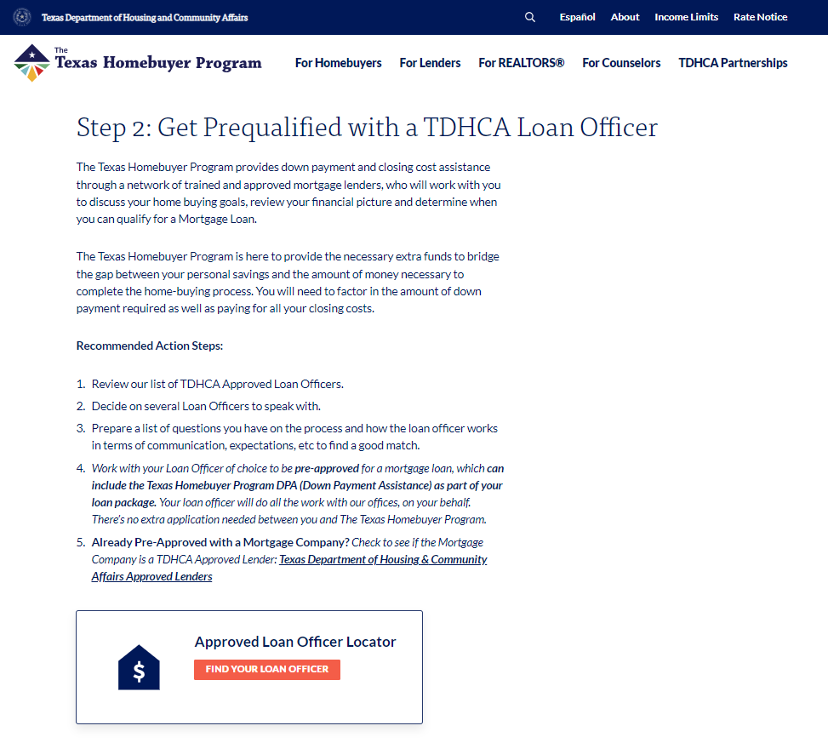

Slide 13
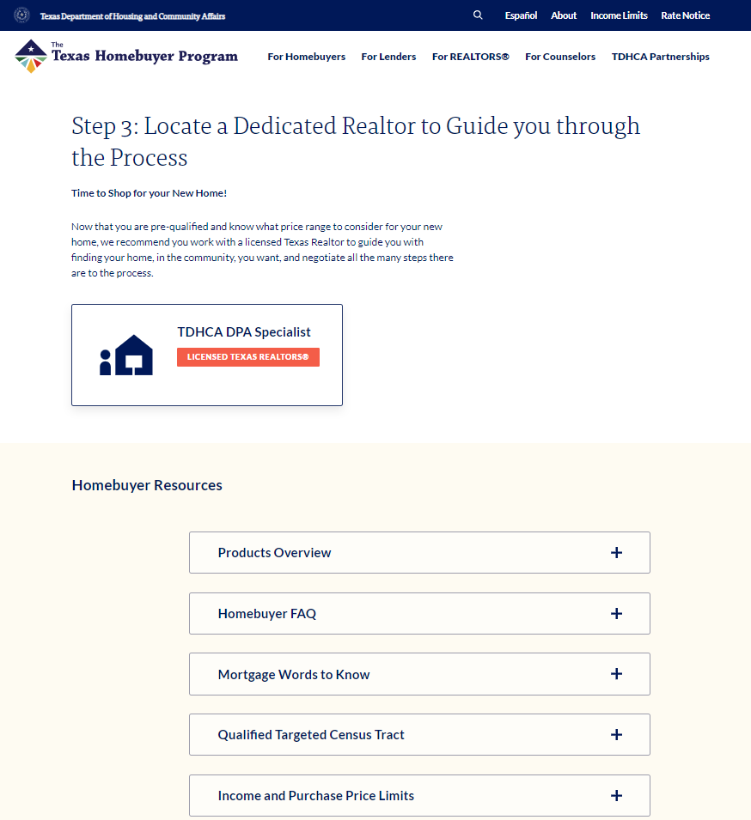

Slide 14


QUICK LINKS
Homebuyer Step-By-Step
Homebuyer Education Course Options
TDHCA Approved Lenders
Find a Realtor
Available Programs and Rates
Additional Gift Fund Options

Slide 15

CONTACT US
Texas Homeownership Division
1-800-792-1119
TxHomebuyer@TDHCA.Texas.Gov
THETEXASHOMEBUYERPROGRAM.COM

